Slide 1
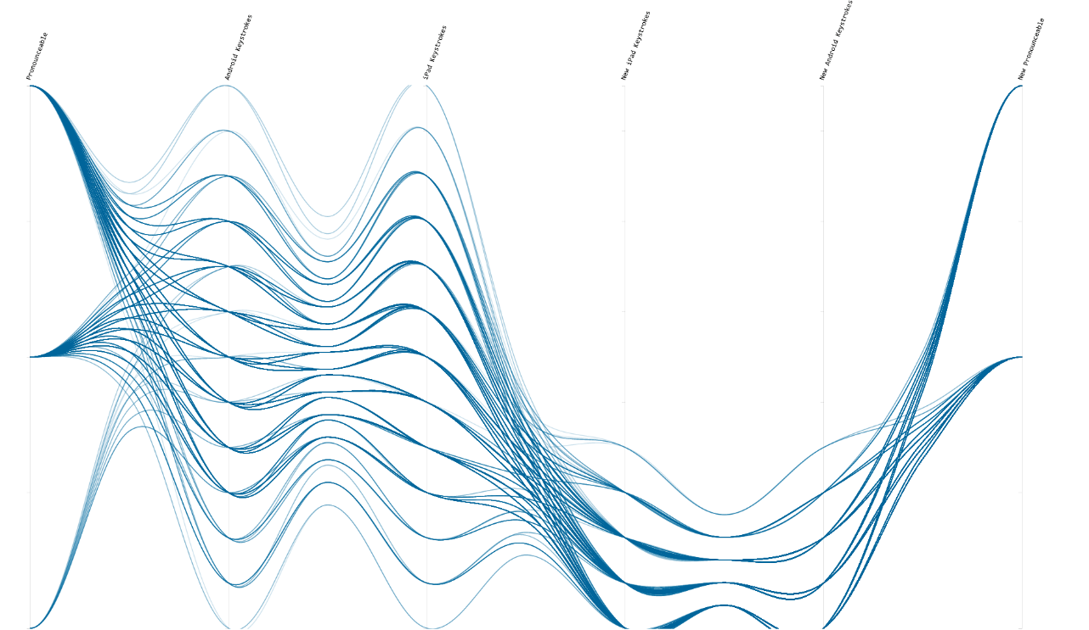
information VISUALIZATION
Cathryn Ploehn

Slide 2
What is visualization?
◕ ◡ ◕

Slide 3
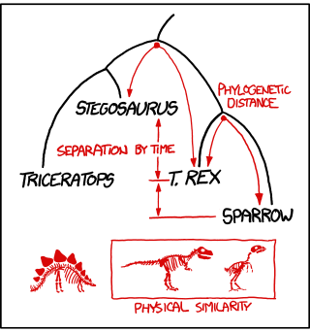

Slide 4
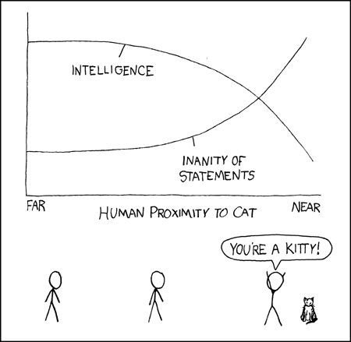

Slide 5
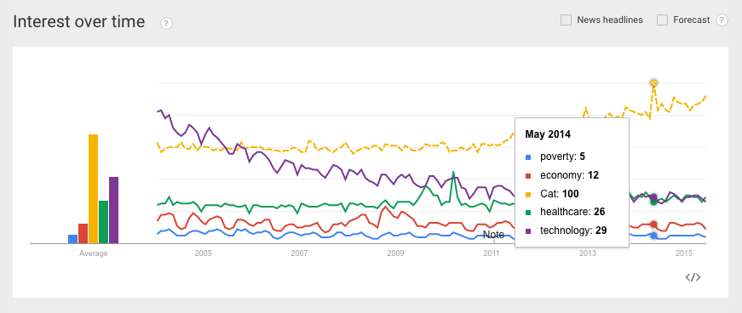

Slide 7
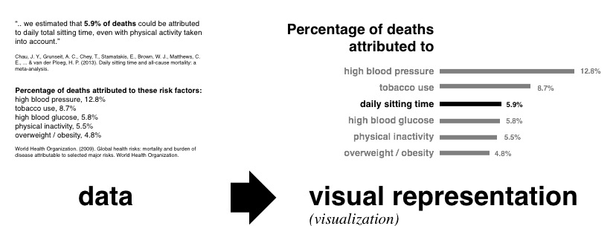

Slide 11
Visualization is a study of transformation from data to visual representations
“
Chen et al. 2014

Slide 12
Visualization is a study of transformation from data to visual representations in order to facilitate ↴
“
Chen et al. 2014

Slide 13
Visualization is a study of transformation from data to visual representations in order to facilitate ↴ effective and efficient cognitive processes in performing tasks involving data."
“
Chen et al. 2014

Slide 14
Visualizations facilitate effective and efficient cognitive processes

Slide 15
Visualizations facilitate performing tasks involving data

Slide 17
What is information visualization?
◕ o ◕

Slide 18
What is information visualization?
visual analytic tools for exploring and extracting patterns from abstract data.

Slide 19
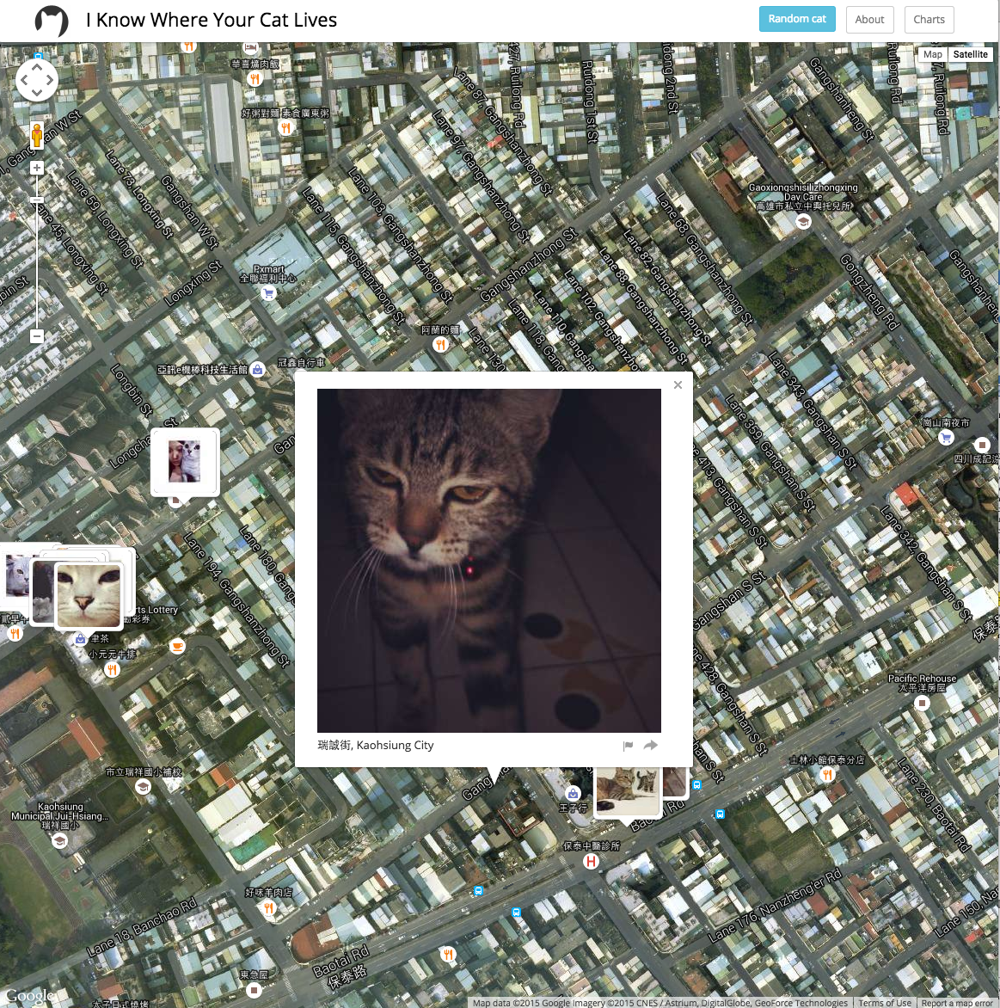

Slide 20
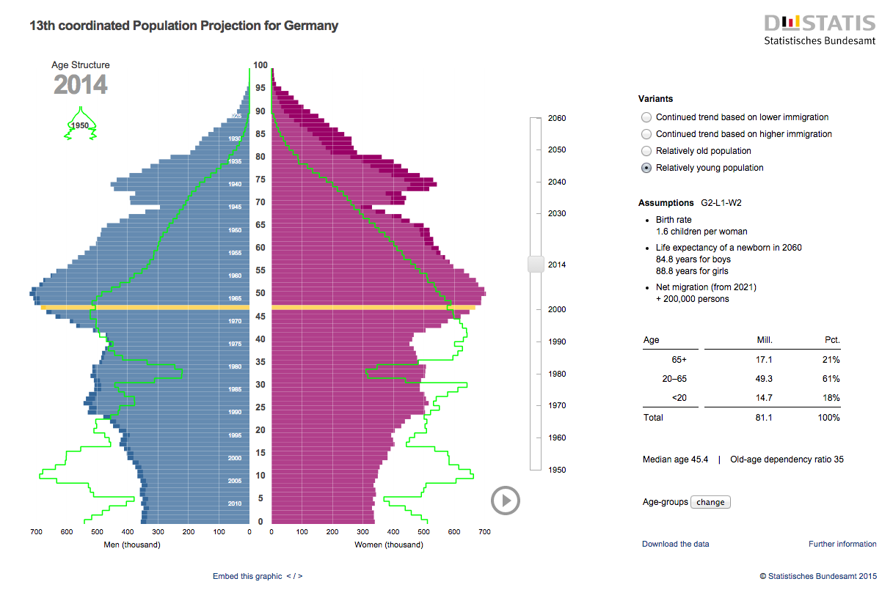

Slide 22
Why create visualizations?

Slide 23
"The graph retains the information in the data"
Cleveland 1994

Slide 24
Why create visualizations?
Explore data structure
“Convey the wealth of information that exists in data”
Encounter surprises in the data
"strengthen our mental abilities"

Slide 25

Visualization saves time.
Chen et al. 2014

Slide 26
How do you assess information visualization?
Very carefully

Slide 28
what are the components of visualization?

Slide 30
[important pieces of viz]
Tasks, context, cognition

Slide 31
How do you assess information visualization?

Slide 32
Designing a visualization evaluation

Slide 33
Important components of information visualization
Cognition
usability
Context
Problems
Goals
Tasks

